Slide 1
Chenbro Micom
2025Q2 Investor Presentation
Aug 7, 2025
ir@chenbro.com

Slide 2

Safe Harbor Notice
This presentation contains certain forward-looking statements that are based on current expectations and are subject to known and unknown risks and uncertainties that could cause actual results to differ materially from those expressed or implied by such statements.
Except as required by law, we undertake no obligation to update any forward-looking statements, whether as a result of new information, future events or otherwise.
The financial numbers presented are based on International Financial Reporting Standards (IFRS). Consolidated numbers were CPA reviewed / audited.

Slide 3

25Q2 Results Highlight
Revenue
Gross Profit
NT$4,154M
NT$ 1,628M
QoQ
31.0%
YoY
50.9%
QoQ
35.8%
YoY
78.3%
GM
29.9%
Operating Profit
EPS
NT$ 1,244M
NT$6.87
QoQ
40.6%
YoY
113.4%
OPM
22.9%
QoQ
24.2%
YoY
82.2%

Slide 4
25H1 Results Highlight
Revenue
Gross Profit
NT$9,597M
NT$ 2,828M
YoY
50.4%
YoY
76.5%
GM
29.5%
Operating Profit
EPS
NT$ 2,129M
NT$12.40
YoY
107.3%
OPM
22.2%
YoY
82.4%

Slide 5
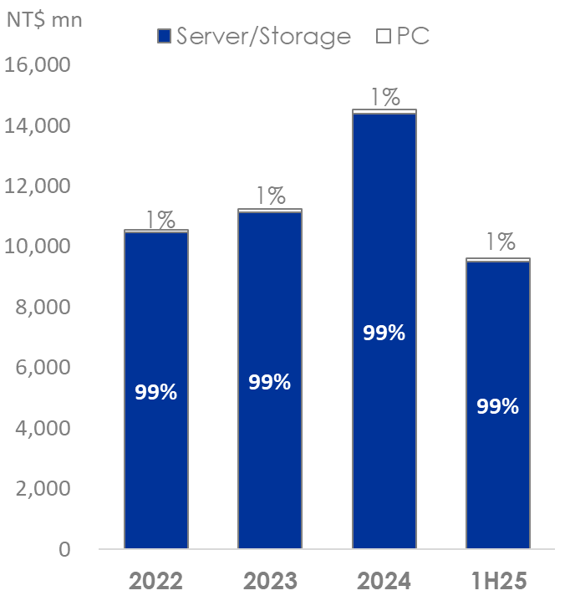
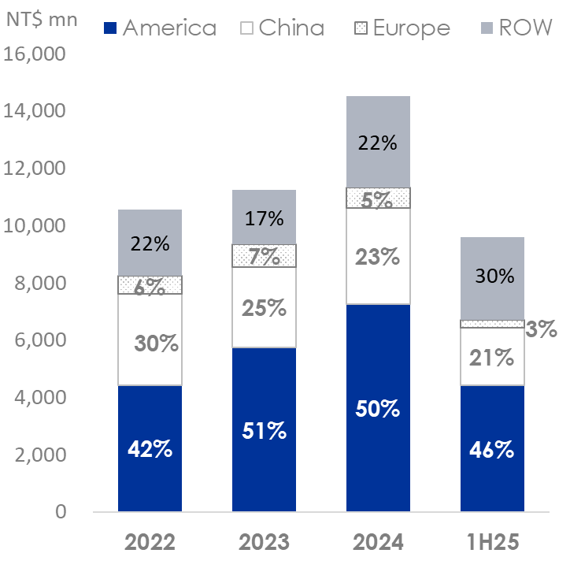
Revenue Breakdown
By Product
By Geography

Slide 6
2025Q2 - Quarterly Income Statement
(NT$Mn) | 25Q2 | 25Q1 | QoQ | 24Q2 | YoY
Net Revenue | 5,443 | 4,154 | 31.0% | 3,607 | 50.9%
Gross Profit | 1,628 | 1,199 | 35.8% | 913 | 78.3%
Operating Profit | 1,244 | 885 | 40.6% | 583 | 113.4%
Non-Operating Income(Loss) | (108) | 18 | (700.0%) | 25 | (532.0%)
Pretax Profit | 1,137 | 903 | 25.9% | 608 | 87.0%
Tax Expenses | 292 | 226 | 29.2% | 151 | 93.4%
Net Profit to Parent | 829 | 667 | 24.3% | 453 | 83.0%
EPS(NT$) | 6.87 | 5.53 | 24.2% | 3.77 | 82.2%
Key Financial Ratios | 25Q2 | 25Q1 | QoQ | 24Q2 | YoY
Gross Margin | 29.9% | 28.9% | 3.5% | 25.3% | 18.2%
Operating Expense Ratio | 7.3% | 8.8% | (17.0%) | 9.4% | (22.3%)
Operating Margin | 22.9% | 21.3% | 7.5% | 16.2% | 41.4%
Net Margin to Parent | 15.2% | 16.1% | (5.6%) | 12.6% | 20.6%
Effective Tax Rate | 25.7% | 25.0% | 2.8% | 24.8% | 3.6%

Slide 7
2025H2 - Income Statement
(NT$Mn) | 25H1 | 24H1 | YoY
Net Revenue | 9,597 | 6,381 | 50.4%
Gross Profit | 2,828 | 1,602 | 76.5%
Operating Profit | 2,129 | 1,027 | 107.3%
Non-Operating Income(Loss) | (89) | 75 | (218.7%)
Pretax Profit | 2,040 | 1,102 | 85.1%
Tax Expenses | 517 | 269 | 92.2%
Net Profit to Parent | 1,496 | 818 | 82.9%
EPS(NT$) | 12.40 | 6.80 | 82.4%
Key Financial Ratios | 25H1 | 24H1 | YoY
Gross Margin | 29.5% | 25.1% | 17.5%
Operating Expense Ratio | 8.0% | 9.9% | (19.2%)
Operating Margin | 22.2% | 16.1% | 37.9%
Net Margin to Parent | 15.6% | 12.8% | 21.9%
Effective Tax Rate | 25.4% | 24.4% | 4.1%

Slide 8
2025Q2 - Consolidated Balance Sheet
(NT$Mn) | 2025.06.30 | 2025.03.31 | QoQ | 2024.06.30 | YoY
Total Assets | 19,265 | 18,144 | 6.2% | 15,059 | 27.9%
Cash (Note) | 5,275 | 5,133 | 2.8% | 3,348 | 57.6%
NR & AR | 4,740 | 4,084 | 16.1% | 3,787 | 25.2%
Inventories | 2,685 | 2,671 | 0.5% | 1,834 | 46.4%
Fixed Assets | 5,676 | 5,420 | 4.7% | 5,298 | 7.1%
Total Liabilities | 11,754 | 10,133 | 16.0% | 8,933 | 31.6%
Total Bank Loans | 2,772 | 2,722 | 1.8% | 2,566 | 8.0%
Bonds payable | 946 | 965 | (2.0%) | 951 | (0.5%)
NP & AP | 4,567 | 4,237 | 7.8% | 3,069 | 48.8%
Total Equity | 7,395 | 7,911 | (6.5%) | 6,060 | 22.0%
Key Financial Ratios | 2025.06.30 | 2025.03.31 | QoQ | 2024.06.30 | YoY
AR Turnover Days(a) | 80 | 85 | (5.9%) | 106 | (24.5%)
Inventory Turnover Days(b) | 66 | 75 | (12.0%) | 70 | (5.7%)
AP Turnover Days(c) | 112 | 123 | (8.9%) | 117 | (4.3%)
CCC Days(a+b-c) | 34 | 37 | (8.1%) | 59 | (42.4%)
Note:
(1) Including current financial assets at amortized cost, net-current/non-current.

Slide 9
2025Q2 - Consolidated Cash Flow Statement
(NT$Mn) | 25Q2 | 24Q2 | YoY
Beginning Balance (Note 1) | 4,541 | 2,980 | 52%
Cash inflow generated from operations | 1,527 | 721 | 112%
Capital expenditures | (545) | (506) | 8%
Proceeds from short-term/long-term debt | 105 | (960) | 111%
Proceeds from convertible bonds | 0 | 1,092 | 100%
Others | (353) | 21 | (1781%)
Ending Balance (Note 1) | 5,275 | 3,348 | 58%
Note 1：Included Current/Non-current financial assets at amortised cost

Slide 10
Dividend Distribution
 | 2020 | 2021 | 2022 | 2023 | 2024
EPS(NT$) | 8.16 | 5.62 | 8.32 | 9.03 | 16.05
Dividend(NT$) | 4.00 | 3.00 | 4.00 | 5.00 | 7.50
Dividend Yield | 5.1% | 4.6% | 2.6% | 1.7% | 1.5%
Payout Ratio | 61% | 53% | 48% | 55% | 47%
【Notes】
2020-2024 yields are based on Chenbro’s closing share price on the day before ex-dividend day.
Excluding the one-off disposal gain of selling previous headquarter(Zhonghe office), 2020 payout ratio is 61%.

Slide 11




Business Outlook
As an Enclosure Solution Provider, Chenbro expanded into the customized rack business this year, leveraging its technical expertise to develop a potential new product line.
In 2025, AI-related demand has surpassed expectations, general-purpose models are recovering, and project deliveries are on schedule. The rack business is progressing as planned, reinforcing confidence in full-year growth.
Amid ongoing global uncertainties, Chenbro continues to monitor geopolitical and trade developments, maintain client communication, and accelerate global manufacturing localization.
Construction of the North American NCT facility and Malaysian plant is underway, with operations set for late 2025 and early 2026. U.S. production planning is also being fast-tracked to meet growing demand and adapt to market changes.

Slide 12
?
?
?
Q & A
?

